Slide 1



Indian Institute of Information Technology (IIIT), Nagpur TantraFiesta 2022 Team Virtuoso
Members :-
Chirag Goel(Team Leader)
Ritik Kumar
Utsav Rai

Slide 2
Problem statement
Colleges acquire various components through tender, which takes a long time because the tender allocation procedure takes more than two months. It is frequently noticed that following tender allocation, the fulfilment of the requisite tender takes longer than expected. It takes more than 6 months to complete the procedure from tender allocation to tender completion since universities must compare all essential components. Addressing this issue would assist colleges in having transparency and parity in the costs of commodities acquired by different college organisations, and the entire tender allocation procedure will take much less time than it does currently

Slide 3
Objective
Develop a software (mobile/web app) which offers numerous things along with specs, prices, warranties, and compares them to choose the best alternative, such as one available for various insurance policies, etc. This may prevent the need to invite tenders, and so on. This may also result in greater openness and parity in the prices of products purchased by various college organisations.

Slide 4
Our Approach
OUR team created a website using following tech stacks to tackle this problem
html
Css
Javascript
Css frameworks namely tailwind css

Slide 5
Javascript solution
(function() {
let field = document.querySelector('.row');
let li = Array.from(field.children);
function SortProduct() {
let select = document.getElementById('select');
let ar = [];
for(let i of li){
const last = i.lastElementChild;
const x = last.textContent.trim();
const y = Number(x.substring(1));
i.setAttribute("data-price", y);
ar.push(i);
}
(contd….)

Slide 6
this.run = ()=>{
addevent();
}
function addevent(){
select.onchange = sortingValue;
}
function sortingValue(){
if (this.value === 'default') {
while (field.firstChild) {field.removeChild(field.firstChild);}
field.append(...ar);
}
if (this.value === 'price') {
SortElem(field, li, true)
}
}
(contd….)

Slide 7
function SortElem(field,li, asc){
let dm, sortli;
dm = asc ? 1 : -1;
sortli = li.sort((a, b)=>{
const ax = a.getAttribute('data-price');
const bx = b.getAttribute('data-price');
return ax > bx ? (1*dm) : (-1*dm);
});
while (field.firstChild) {field.removeChild(field.firstChild);}
field.append(...sortli);
}
}
new SortProduct().run();
})();

Slide 8
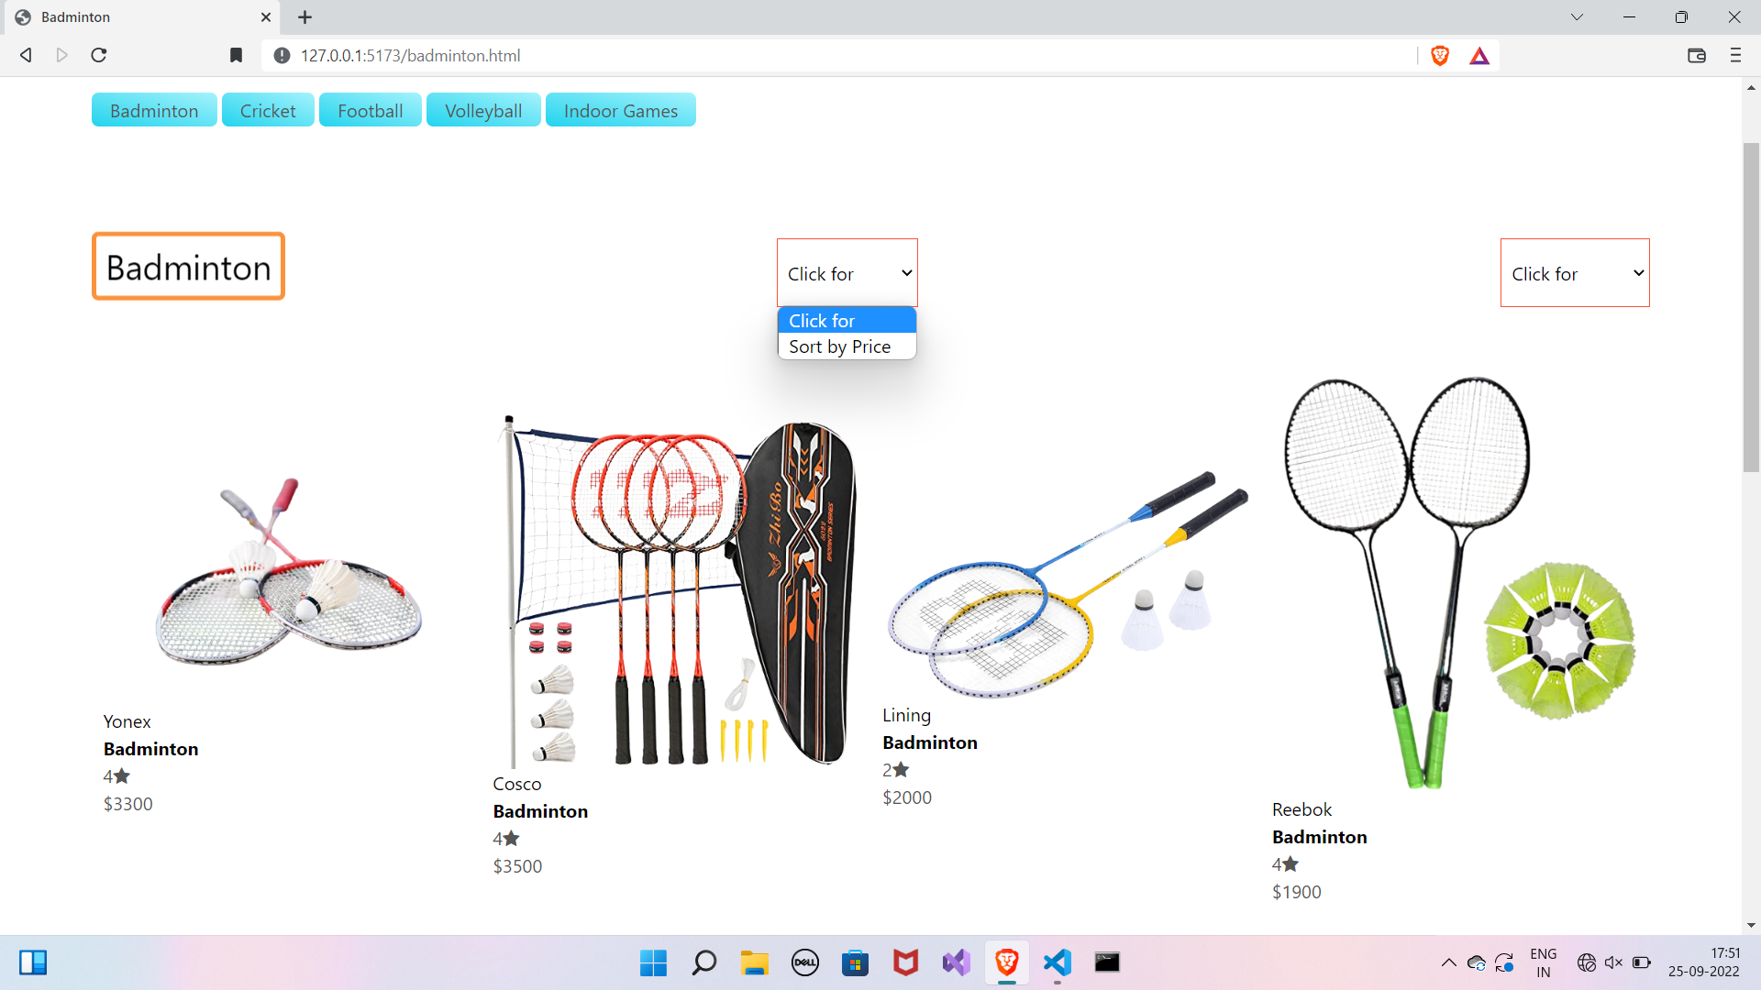
A glimpse of our solution
BEFORE SORTING

Slide 9
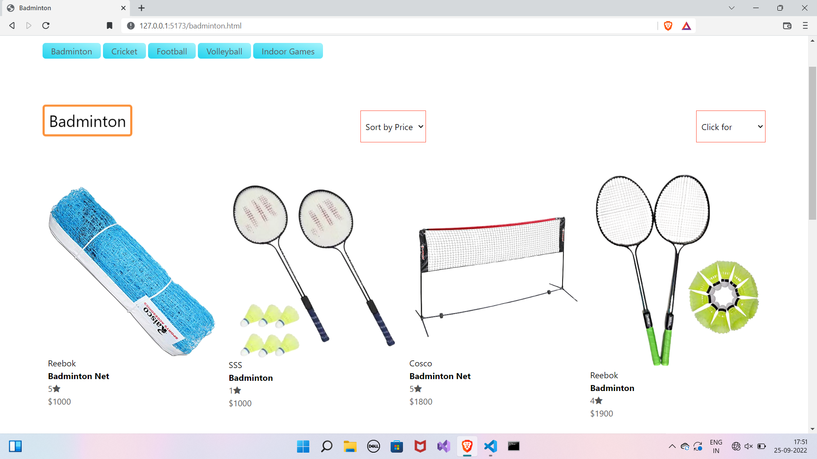
AFTER SORTING

Slide 10
Thank you

